Slide 1

Google PlayStore Analysis

Slide 2

Analysis Objectives
What is the relationship between app size and user ratings?
How do different app categories perform in ratings ?
Does the "Content Rating" affect app installs or user ratings?
What is the distribution of app reviews, and how do they correlate with ratings?
Are there any high-rated categories with
relatively low installs?
App updates Vs. rating
Free & paid apps installs comparison
Factors that contribute most to app popularity.

Slide 3
DATA CLEANING PROCEDURES
Replace “reviews” with numerical as float
Replace “Last Updated” to Date and time
Change the date form
Replace $ with space then remove the space
Delete the “Genres” column
convert the column of “Category” to lowercase
remove “_” in the column of “Category”
Replace< Null> in the “Type”,” content”, and “rating” columns with <0>
Replace <Null> in the “Current Ver” and “ Android Ver” columns with “ top”
Delete the row of” last update” containing <Null>
Replace <Null> in the “Reviews” column with mean

Slide 4
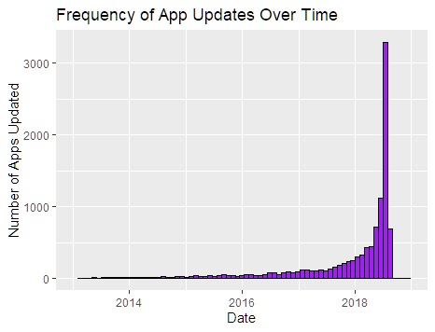
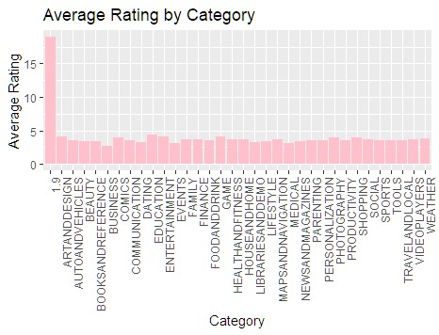
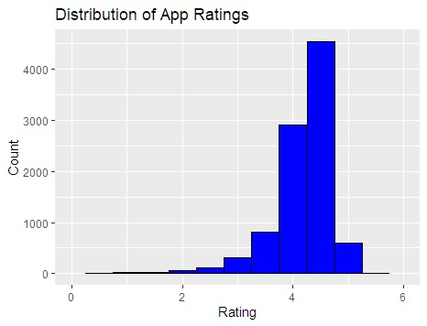
R Visualization

Slide 5
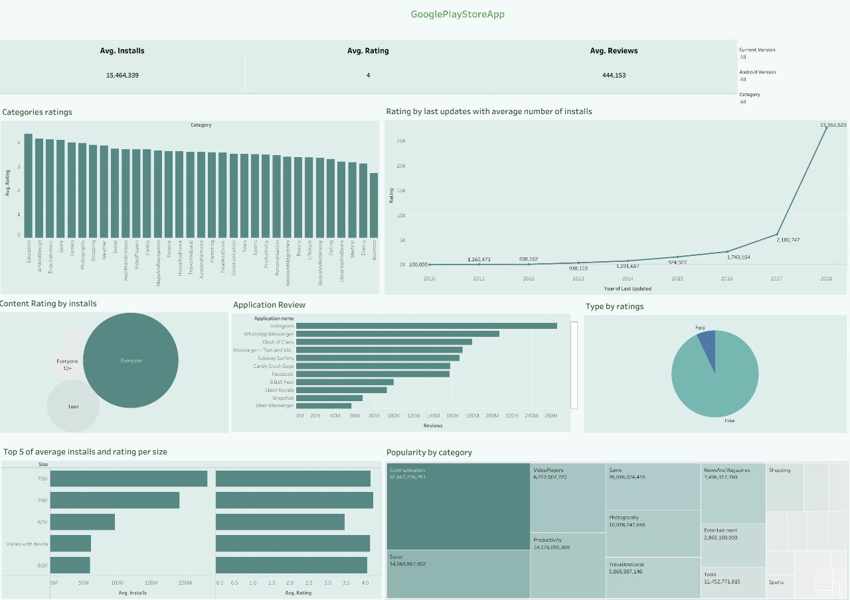
Our Dashboard
https://public.tableau.com/app/profile/nadeen.ahmed2774/viz/Project5_17272102887120/Dashboard1?publish=yes

Slide 6
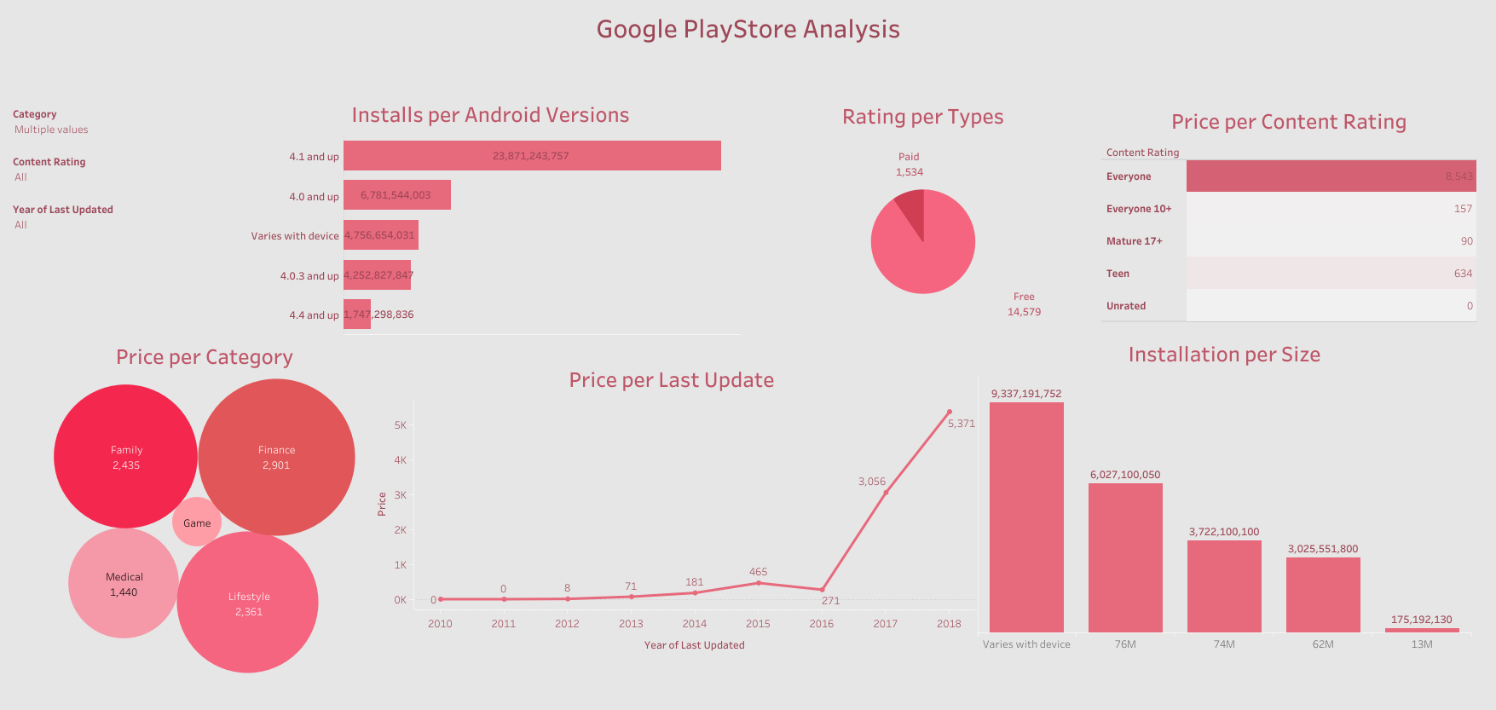
Our Dashboard
https://public.tableau.com/app/profile/omnia.eshra/viz/GooglePlayStore_17272091292810/Dashboard1?publish=yes

Slide 7

Thank you very much!

